Slide 1

Greenhouse Monitoring System
Capacitive Soil Moisture Sensor
Daniel Bujold
https://github.com/DBoo92/317Hardware

Slide 2
Proposal
The goal of this project was to create a system for monitoring soil moisture conditions of plants inside the Humber greenhouse
Such as system can improve plant health, help employees, and increase greenhouse efficiency
Will be consolidated with group members’ projects in CENG 355 to create a full featured system
Project sponsor – Valeria from Humber Nurseries
My sensor: capacitive soil moisture sensor (Gikfun EK1940)
Bonus features: water irrigation system (diaphragm pump - Gikfun EK1856C) and customizable watering level (selector switch)
System will be capable of reading/displaying soil moisture values
If soil moisture is low, system will turn on irrigation system to water the plant
User will be able to select the amount of water too be dispensed (based on plant need)

Slide 3
Budget
Original budget - $188.78
Final project cost - $215.88
Differences from original:
- Pi 4 upgrade
- ADS1115 add-on
- saved on acrylic
Cost for beginner without pre-owned parts - $292.43

Slide 4
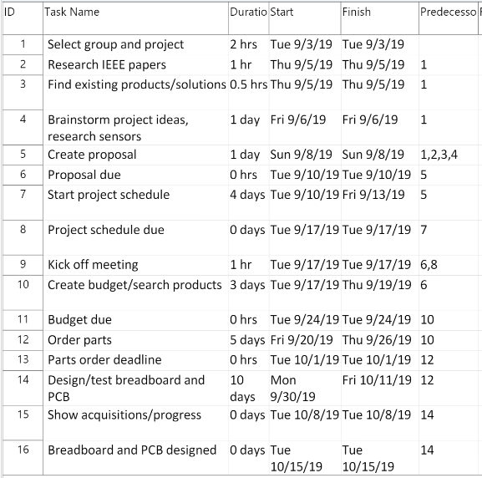
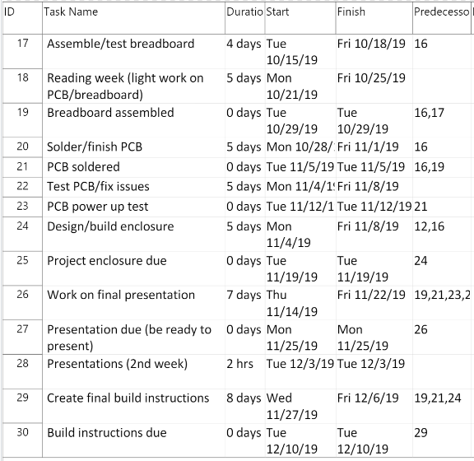
Schedule
Was able to stay on track/ahead of schedule during the semester with minimal roadblocks

Slide 5
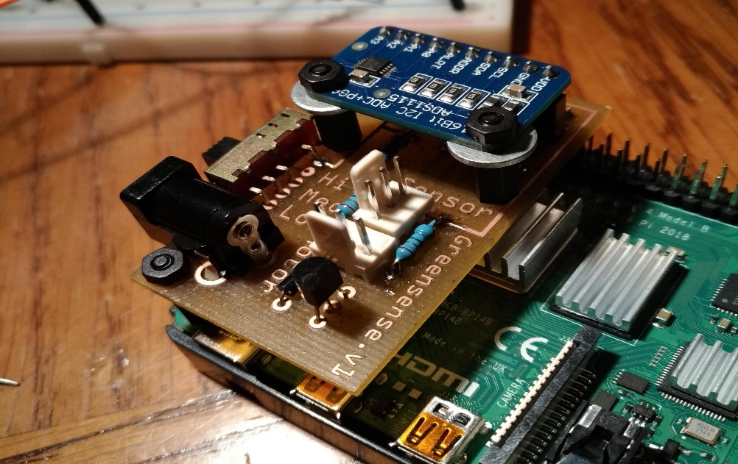
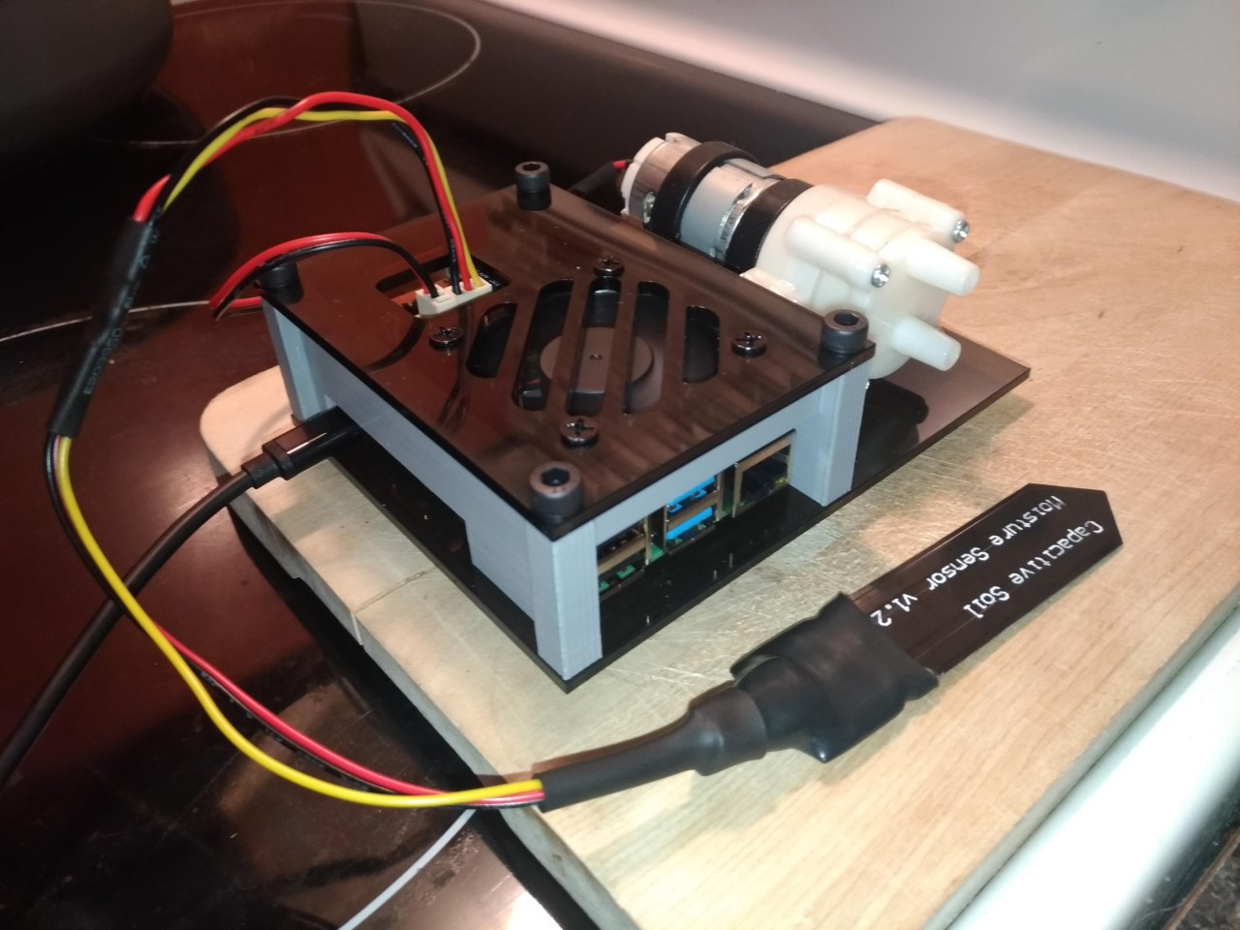
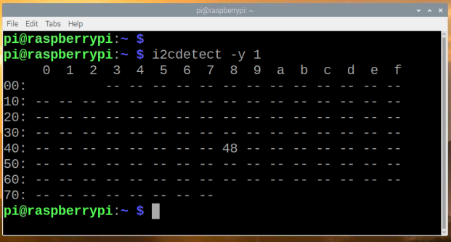
Images of project/hardware
PCB view
Hardware in enclosure
ADS1115 I2C address (0x48)

Slide 6
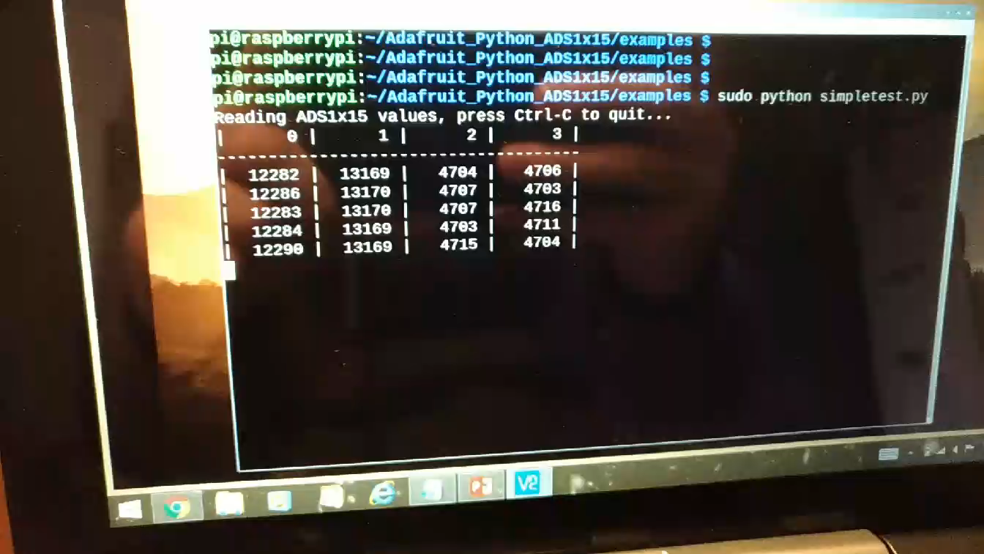
Reading Sensor Video

Slide 7
Previous Course Knowledge Used

